Slide 1

Designing of IoT Solutions
IoT Physical Servers & cloud offering
Rashma.B.M
Department of Computer Science Engineering

Slide 2

Designing of IoT Solutions
IoT Physical Servers & cloud offering
Rashma.B.M
Department of Computer Science Engineering

Slide 3
Designing IOT Solutions
Outline
Xively cloud for IoT
Amazon for IoT
Book website: http://www.internet-of-things-book.com

Slide 4
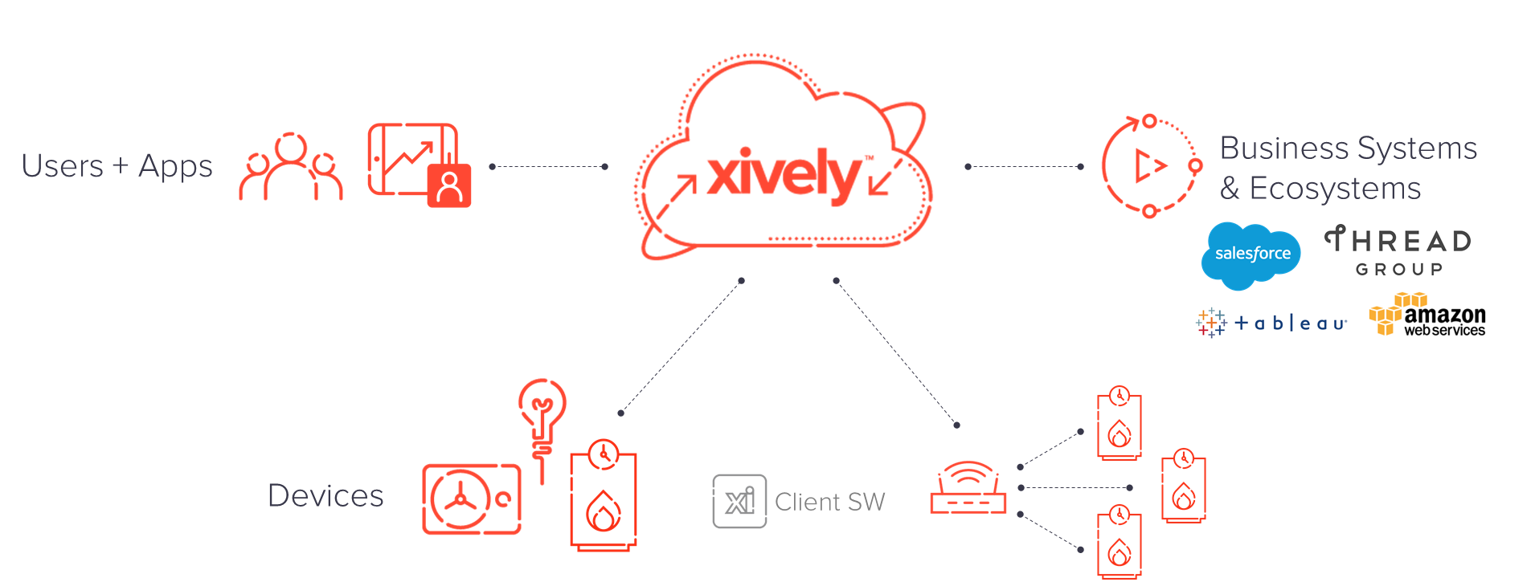
Designing IOT Solutions
Xively cloud

Slide 5
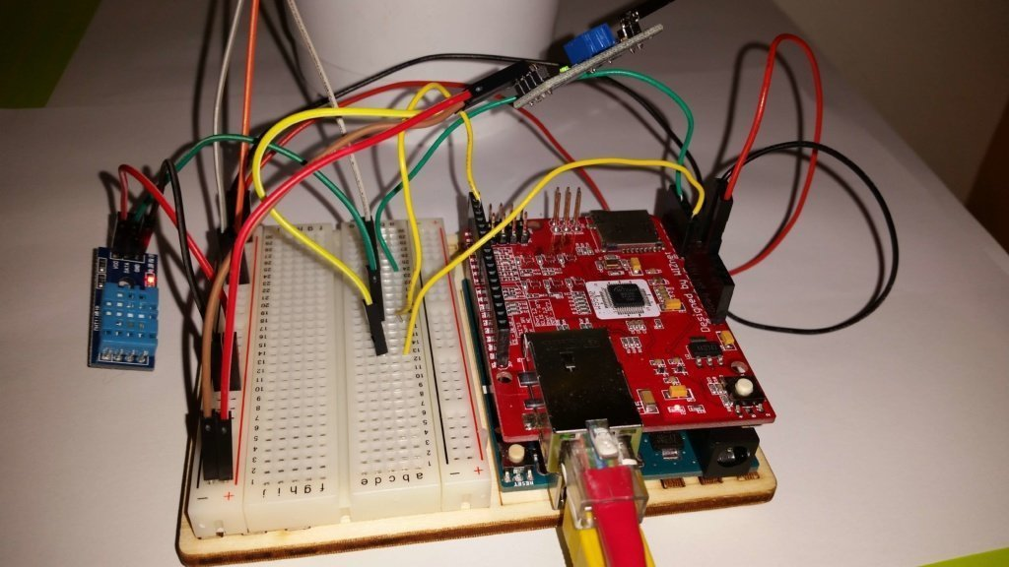
Designing IOT Solutions
Xively cloud : Data logger project
data logger project uses Arduino Uno and a set of sensors:
DHT11: Temperature and humidity sensor
TEMT6000: Light intensity sensor
YL-38 + YL-69: Soil moisture sensor

Slide 6
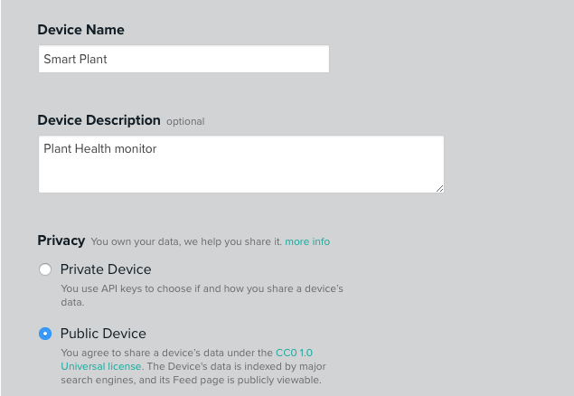
Designing IOT Solutions
Xively cloud
Xively uses some basic concepts:
Xively device: It is your “device” or the IoT project you are building. Consider it as an envelope containing the data.
Channels: It is the streaming coming from your sensors. Usually, the channel number is equal to the sensor number (as long as you want to monitor them all). So the first step is adding the “device” to our account:

Slide 7
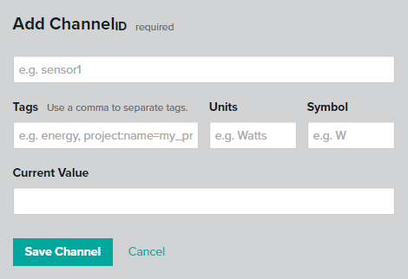
Designing IOT Solutions
Xively cloud

Slide 8
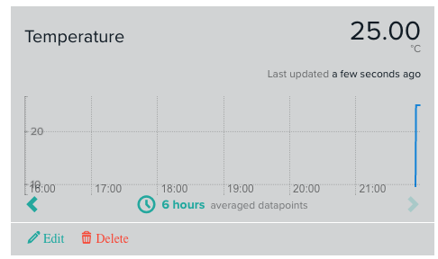
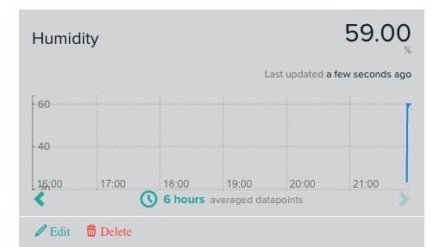
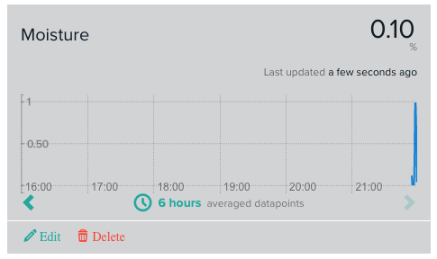
Designing IOT Solutions
Xively cloud

Slide 9
Designing IOT Solutions
Amazon EC2 – Python Example
Boto is a Python package that provides interfaces to Amazon Web Services (AWS)
In this example, a connection to EC2 service is ﬁ rst established by calling boto.ec2.connect_to_region.
The EC2 region, AWS access key and AWS secret key are passed to this function. After connecting to EC2 , a new instance is launched using the conn.run_instances function.
The AMI-ID, instance type, EC2 key handle and security group are passed to this function.
Book website: http://www.internet-of-things-book.com

Slide 10
Designing IOT Solutions
Amazon EC2 – Python Example
#Python program for launching an EC2 instance
import boto.ec2
from time import sleep ACCESS_KEY="<enter access key>" SECRET_KEY="<enter secret key>"
REGION="us-east-1" AMI_ID = "ami-d0f89fb9"
EC2_KEY_HANDLE = "<enter key handle>" INSTANCE_TYPE="t1.micro"
SECGROUP_HANDLE="default"
conn = boto.ec2.connect_to_region(REGION, aws_access_key_id=ACCESS_KEY,
aws_secret_access_key=SECRET_KEY)
reservation = conn.run_instances(image_id=AMI_ID, key_name=EC2_KEY_HANDLE,
instance_type=INSTANCE_TYPE, security_groups = [ SECGROUP_HANDLE, ] )
Book website: http://www.internet-of-things-book.com

Slide 11
Designing IOT Solutions
Amazon Auto Scaling – Python Example
AutoScaling Service
A connection to AutoScaling service is first established by calling boto.ec2.autoscale.connect_to_region function.
Launch Configuration
After connecting to AutoScaling service, a new launch configuration is created by calling conn.create_launch_con f iguration. Launch configuration contains instructions on how to launch new instances including the AMI-ID, instance type, security groups, etc.
AutoScaling Group
After creating a launch configuration, it is then associated with a new AutoScaling group. AutoScaling group is created by calling conn.create_auto_scaling_group. The settings for AutoScaling group such as the maximum and minimum number of instances in the group, the launch configuration, availability zones, optional load balancer to use with the group, etc.
Book website: http://www.internet-of-things-book.com

Slide 12
THANK YOU
Rashma.B.M
Department of Computer Science Engineering
rashmabm@pes.edu

